Slide 1
Employee Attrition Analysis

Slide 2
Overview
Employee attrition data consists of 4410 employee records and 29 fields.
This data has been sourced from Kaggle.

Slide 3
Objective
Employee attrition analysis is a project aimed to grasp the reasons for an employee leaving their company using Data science methods and generate insights.
Analyze attrition rate by gender, explore relationship between salary and performance, department, measure performance and explore relationship and overall reasons.

Slide 4
Methodology
Data pre-processing and manipulation is done using Python and insights drawn using Tableau.

Slide 5
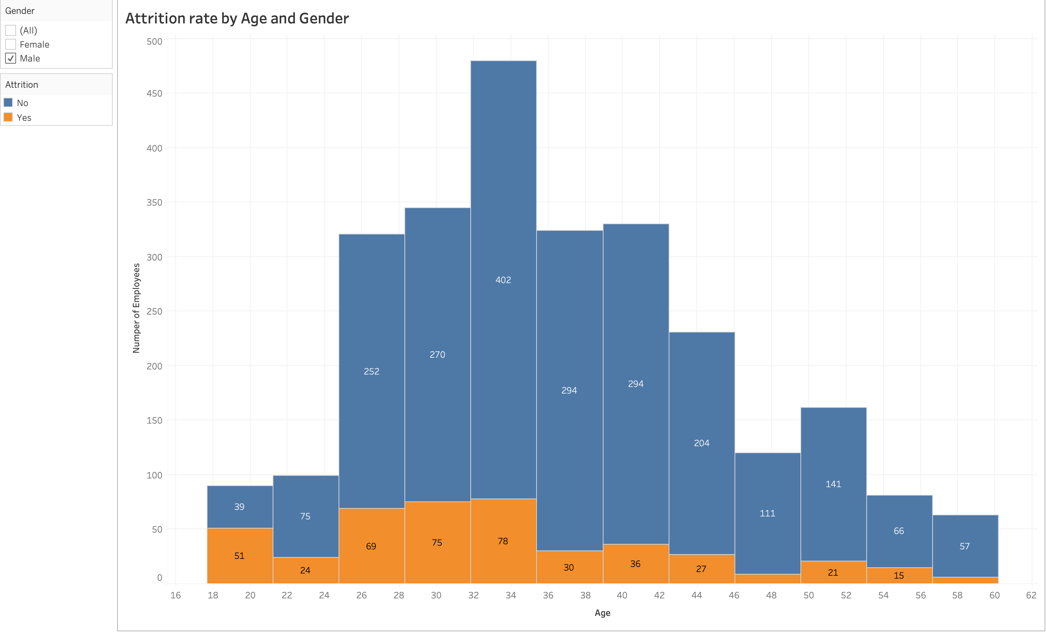
Results
Histogram showing Attrition rate by age and gender, where x and y axes representing Age distribution, Total number of male employees. Highest attrition for male employee’s can be found during the ages of
32-36 . Attrition is generally high between the ages 26-36.

Slide 6
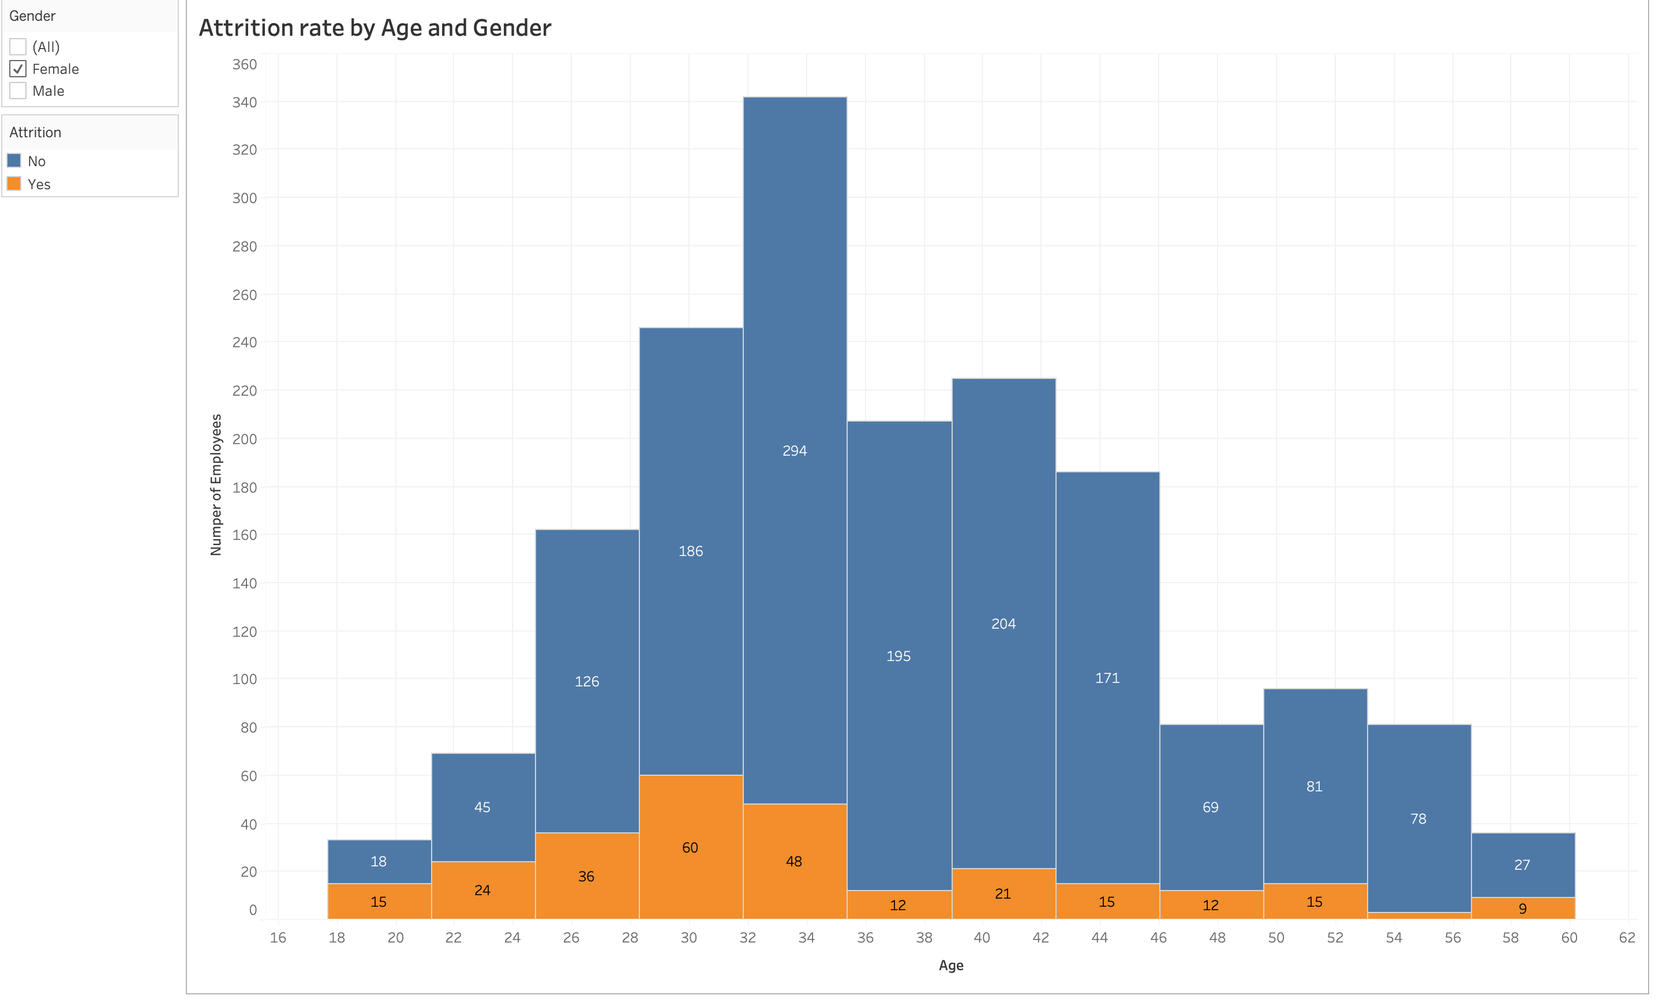
Histogram depicting Attrition rate by age and gender, where x and y axes representing Age distribution, Total number of female employees. Utmost attrition in female employee’s can be found between the age’s 28-32.

Slide 7
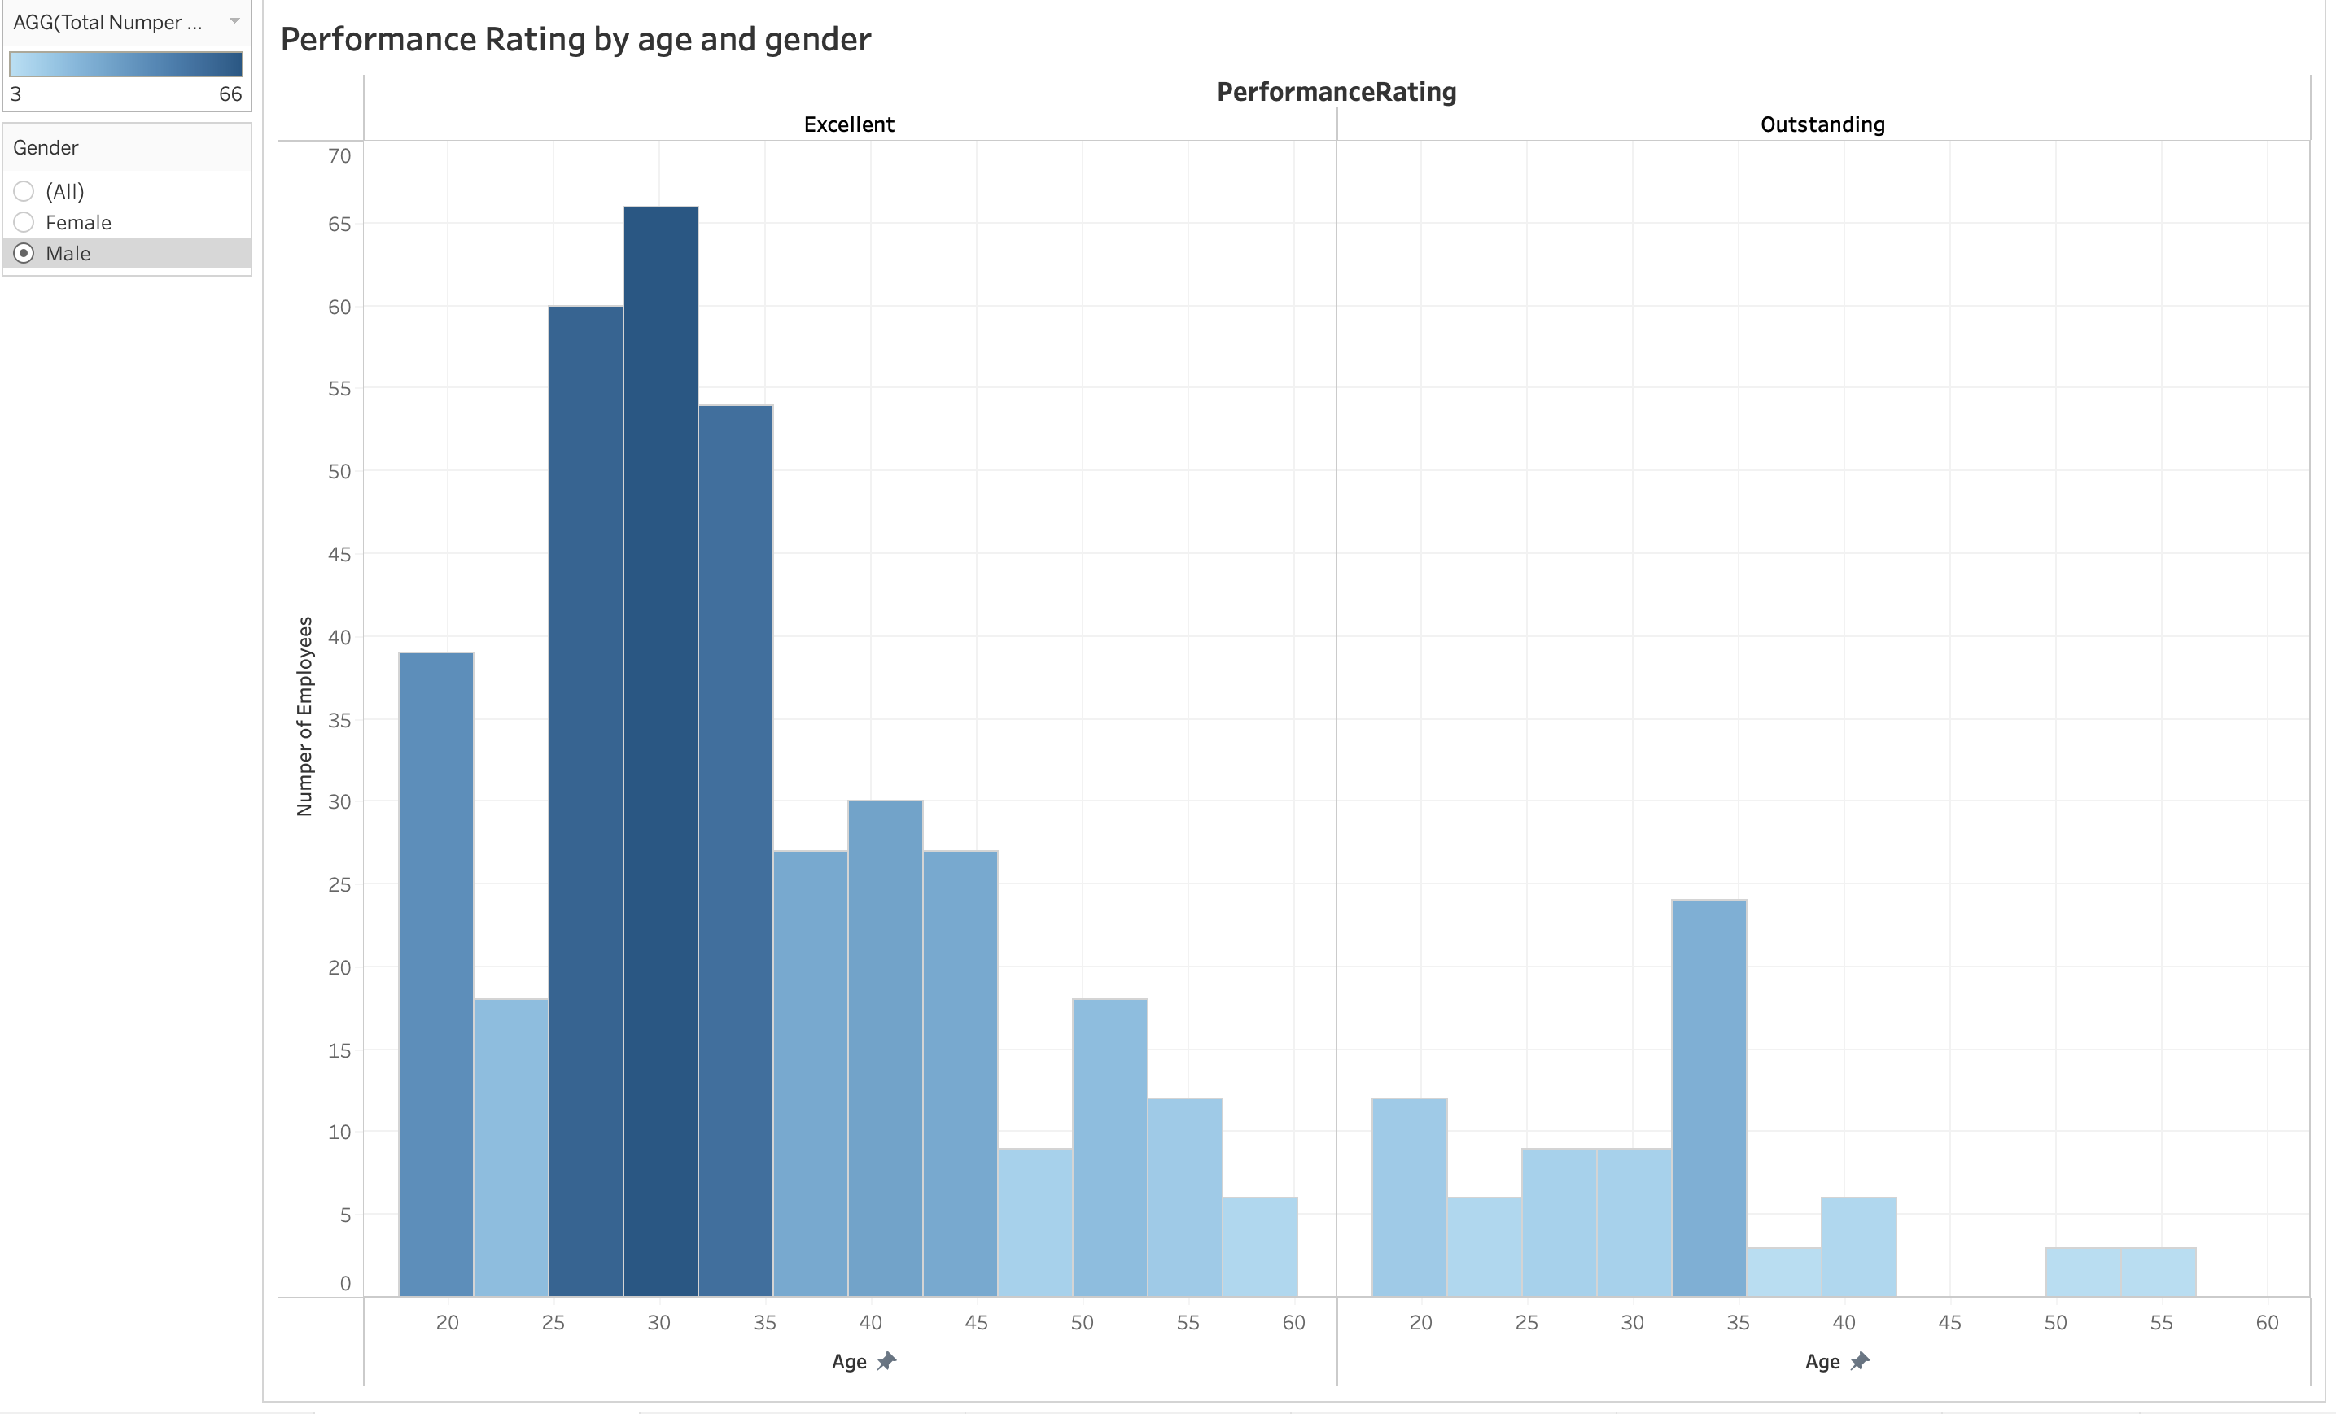
Histogram depicts Performance rating, Age distribution and gender. The X and Y axes represents Age distribution, Number of male employees. High levels of attrition has been influenced by employees whose performance rating is Excellent.

Slide 8
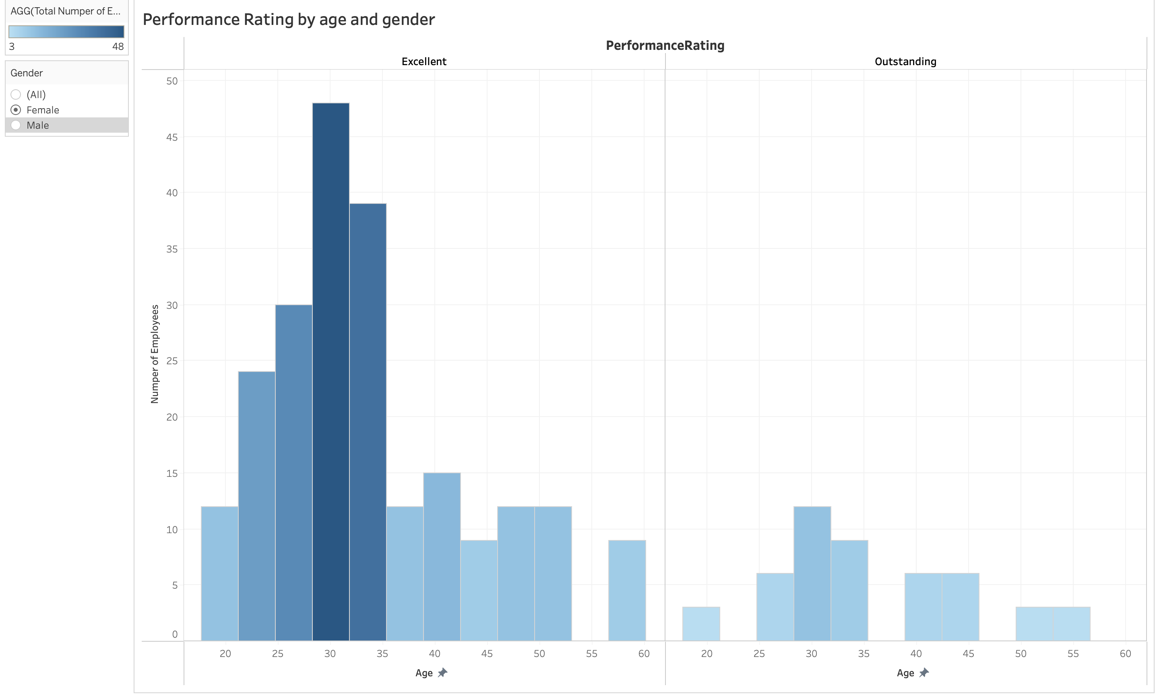
Histogram depicting Performance rating, Age distribution and gender. The X and Y axes representing Age distribution, Number of female employees. Though the Total number varies, High levels of attrition has been influenced by employees whose performance rating is Excellent.

Slide 9
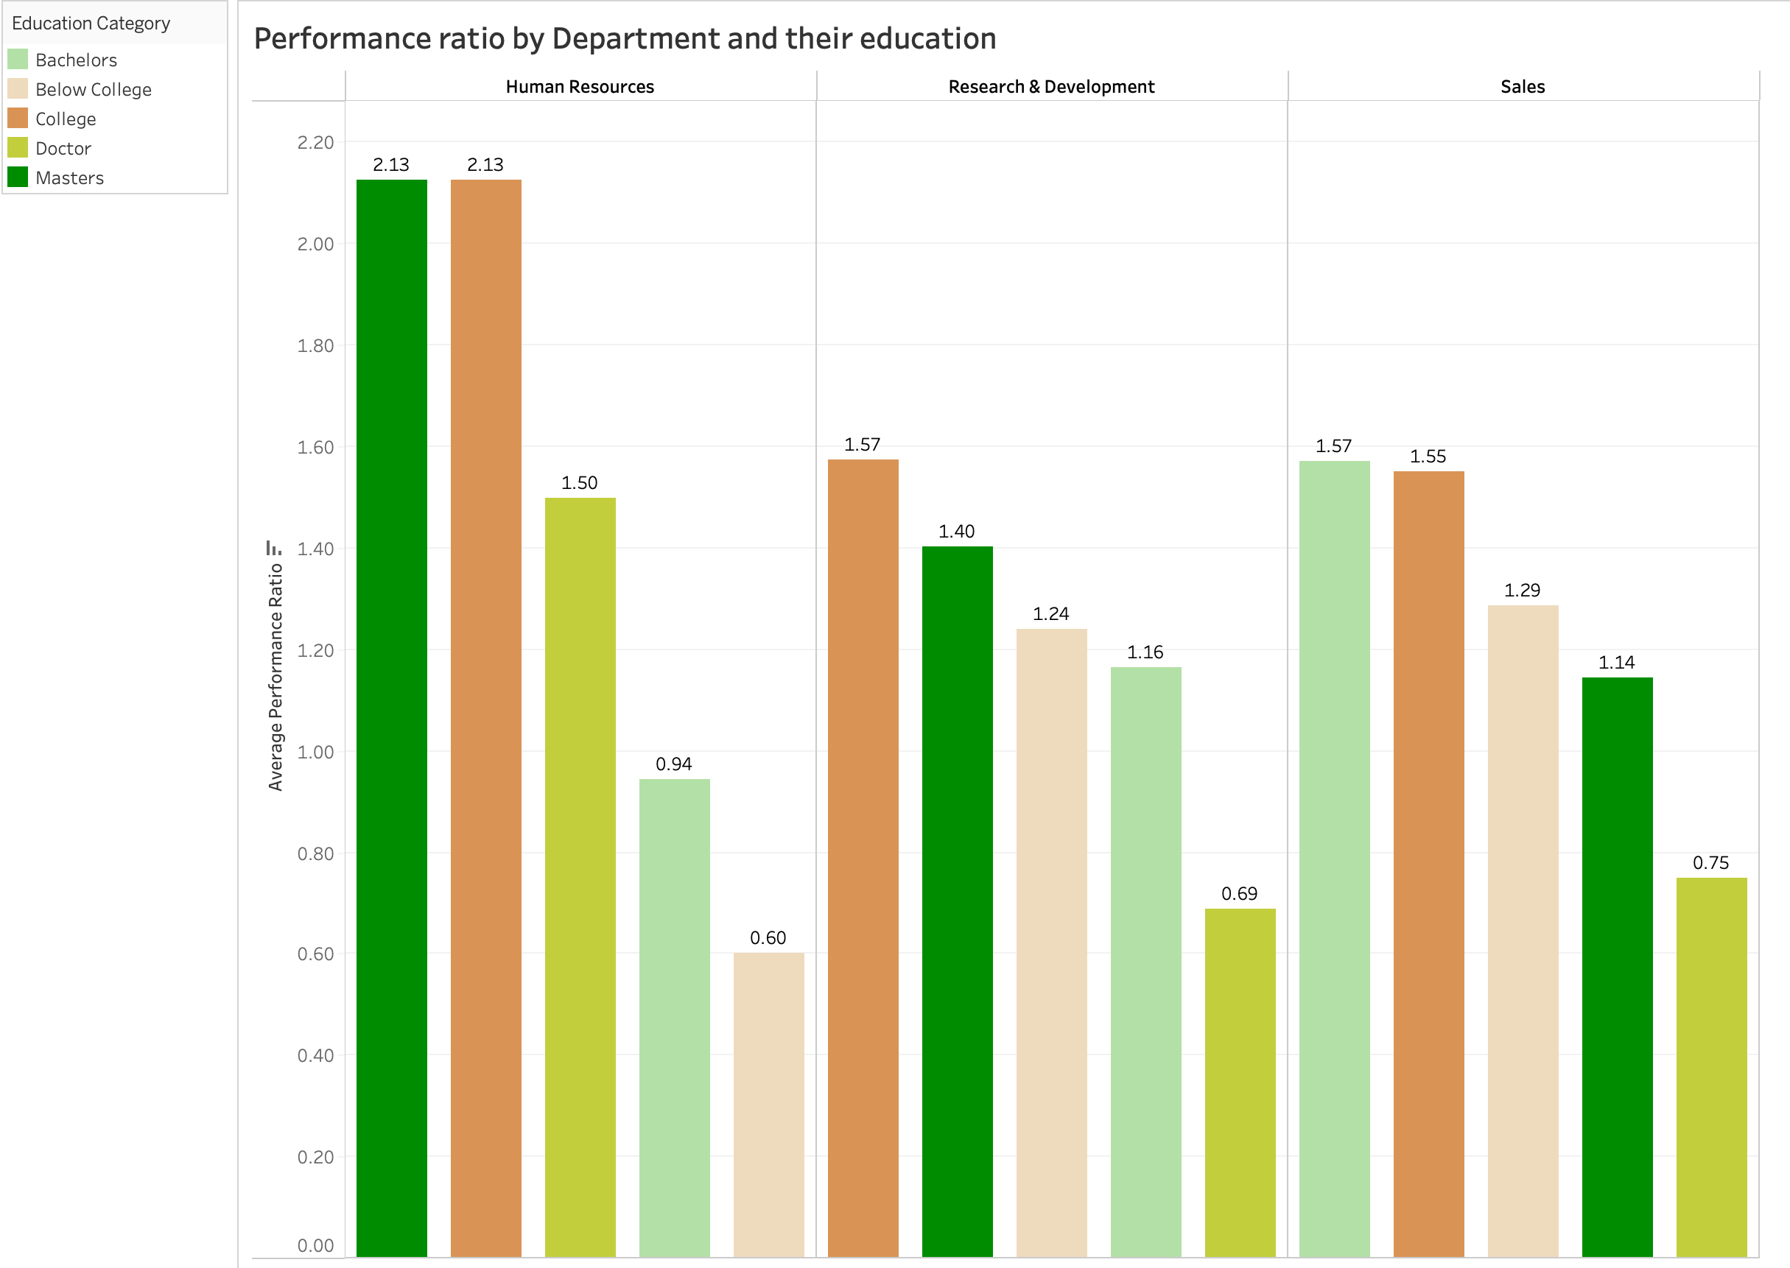
Bar plot depicting Average performance ratio by department. Coincidentally, HR department has the highest attrition rate and Average performance ratio when compared to other departments. Attrition rate in a granular level can be found employees who have either been to College or have a bachelor’s or a masters degree.

Slide 10
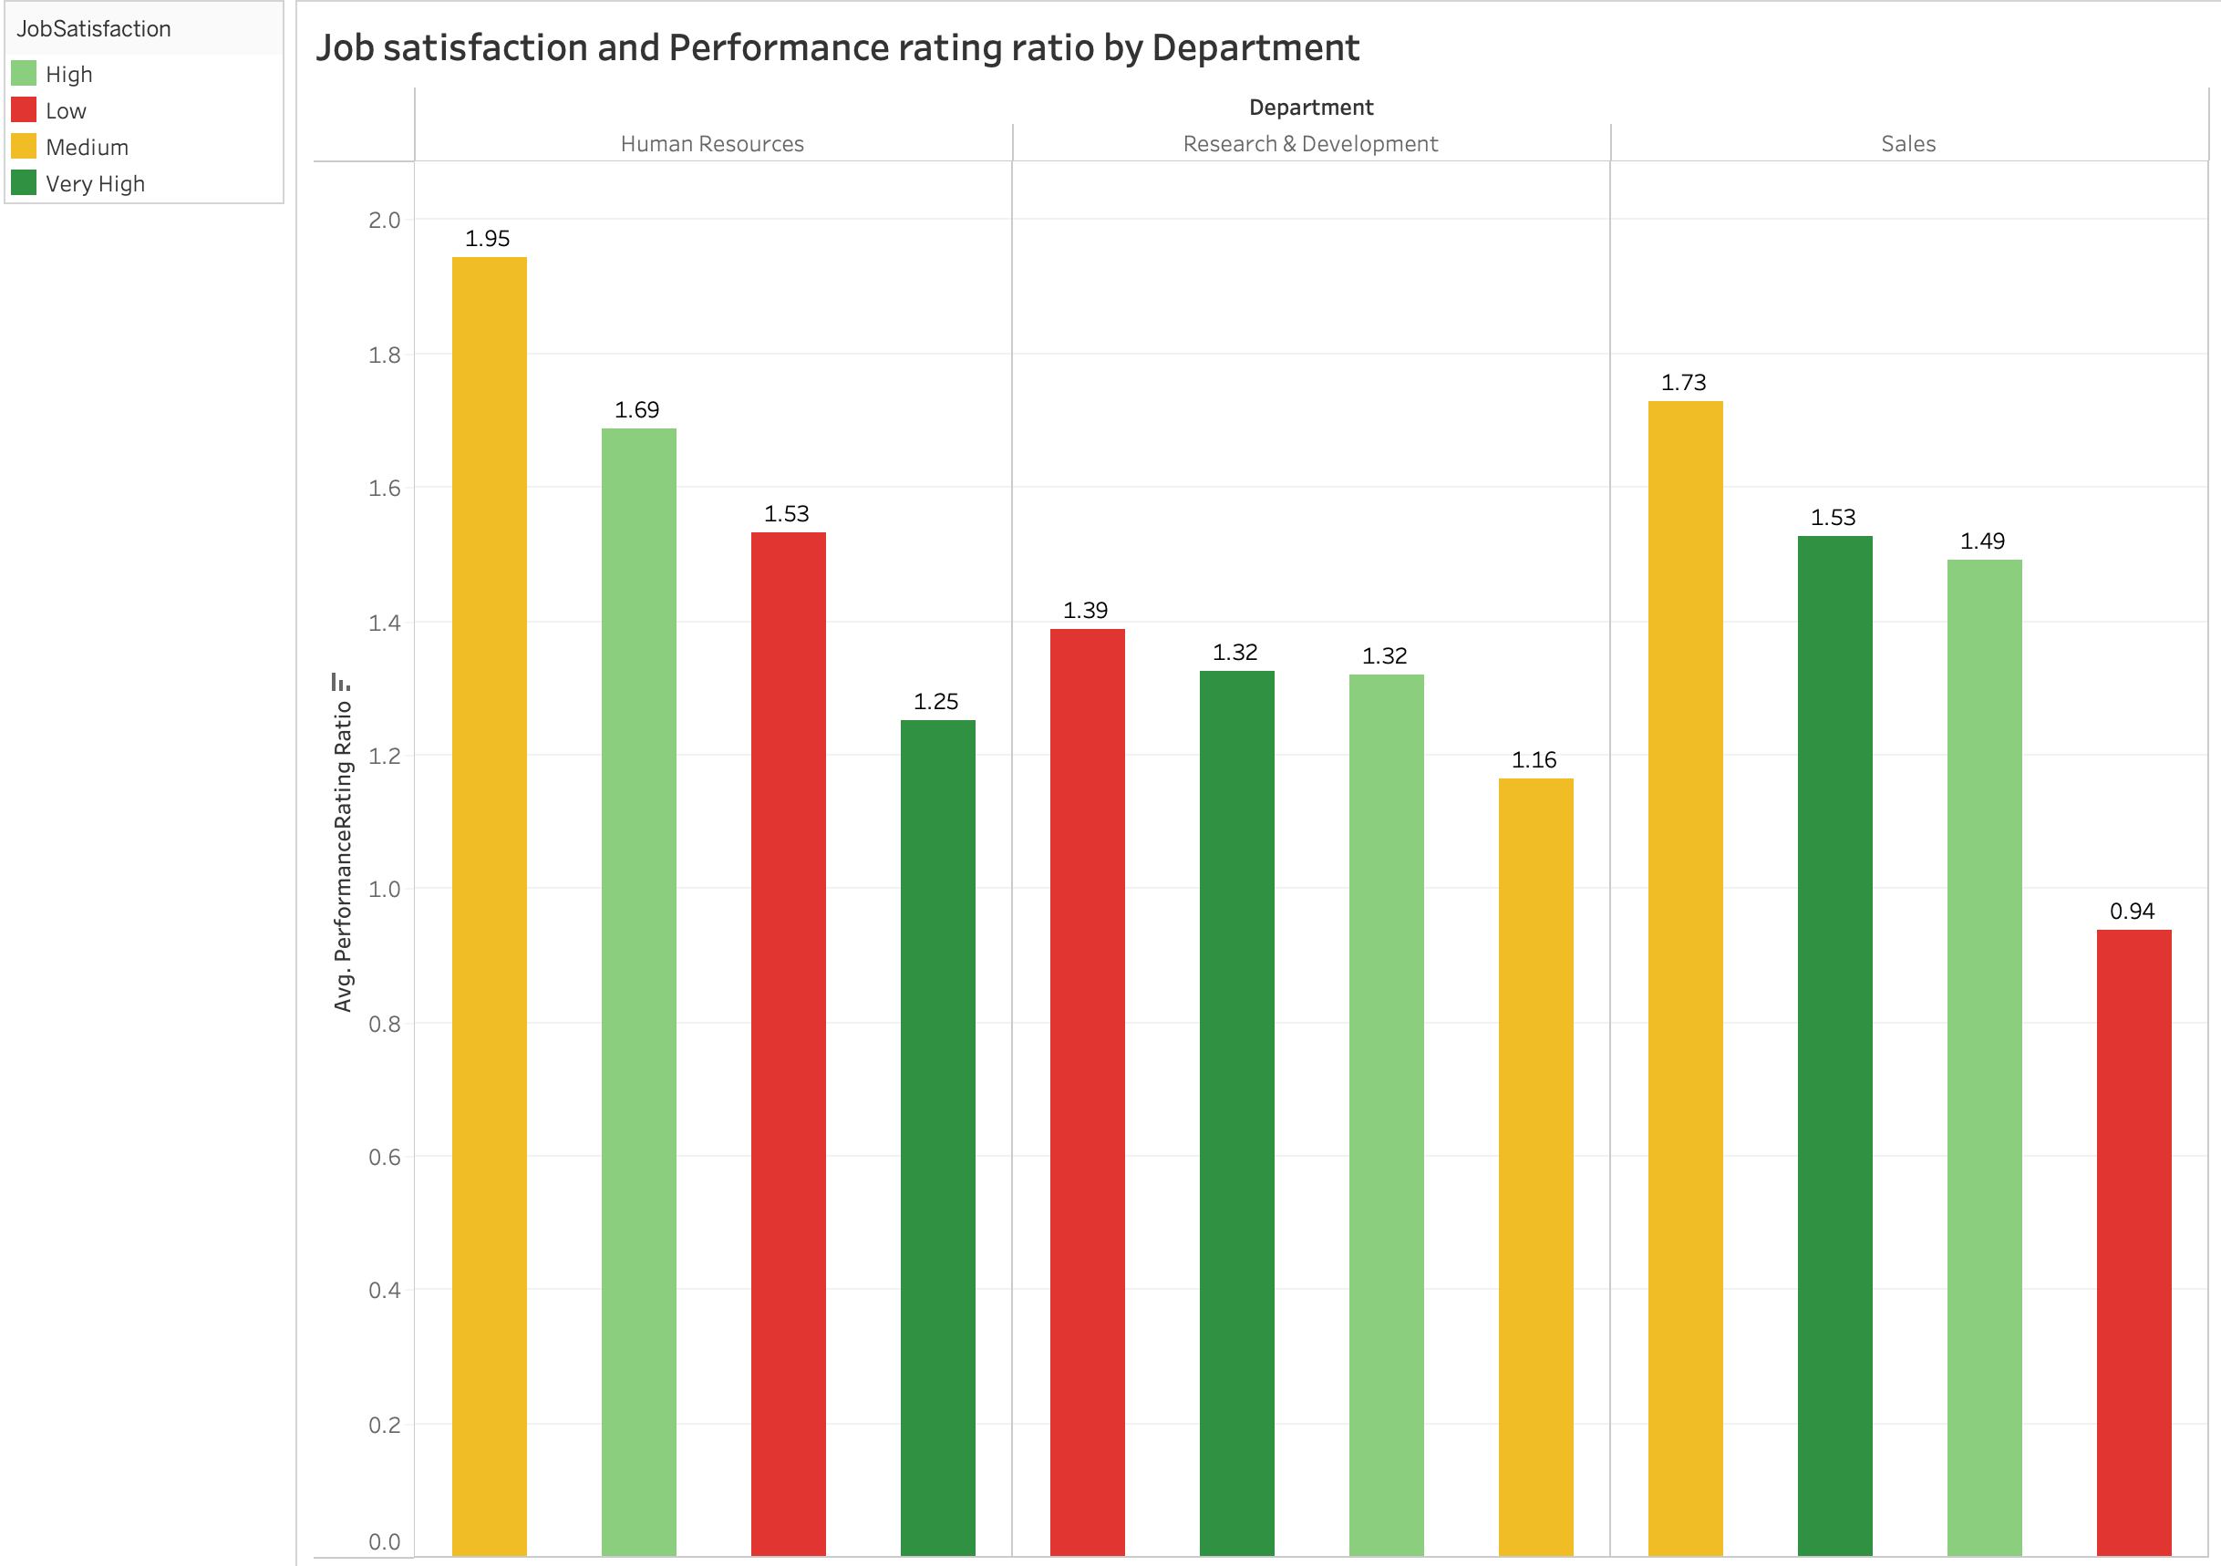
Bar plot showcasing the relationship of Employee attrition Performance Rating ratio, Departments and Job satisfaction.
High attrition rate attributes to Medium and Low job satisfaction in all three departments, even when their Performance rating ration is very high.

Slide 11
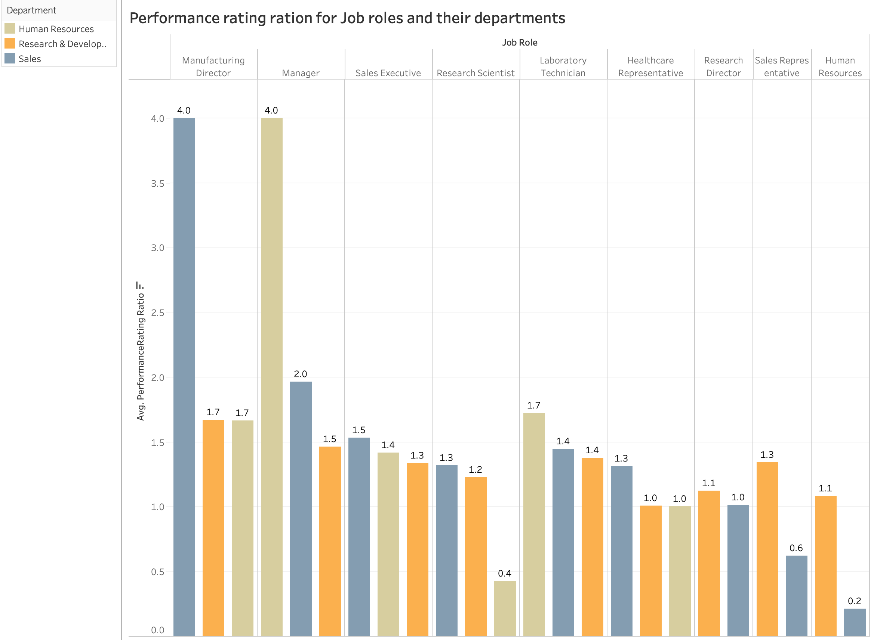
Bar plot depicting High attrition Job roles, their departments by Performance rating. X and Y axes represent Job roles and their average performance rating ratio. Managerial positions in HR and Sales department leads the way for High attrition even with a very high performance rating ratio.

Slide 12
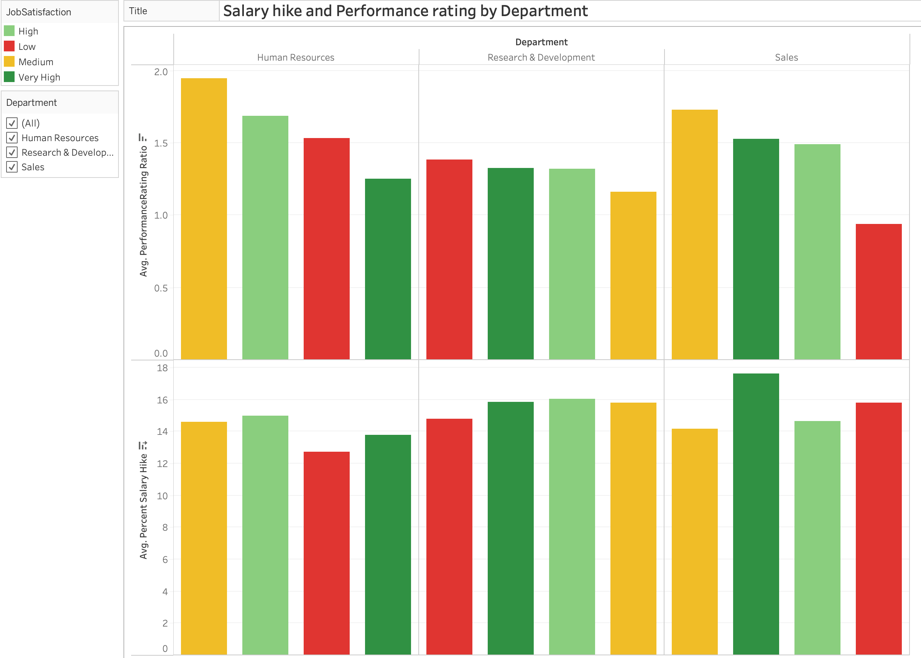
Dual axis bar chart portraying Percent salary hike, Performance rating ratio for different departments by their job satisfaction. The salary hike remained almost similar for all the departments.

Slide 13
Conclusion
Attrition rate high in male when compared to their counterparts.
HR department leads the way for highest attrition.
Employees with Medium Performance rating is one of the major reasons for attrition.
Top tier management had highest attrition among other roles.
Salary hikes has least impact of attrition.

